Slide 1

Peace of Mind, Wherever They Go
📩 Contact
Email: team@safecircle.app
Website: unknown linkunknown link

Slide 2

A Gap in Child Safety Communication
Lack of Real-Time Updates
Existing Tools Insufficient
Parents rely on delayed or incomplete information about their children’s safety
Current tools are too slow, lack privacy, or aren’t designed for immediate updates
Anxiety and Inaction
This creates anxiety and leaves parents unable to act in critical moments

Slide 3
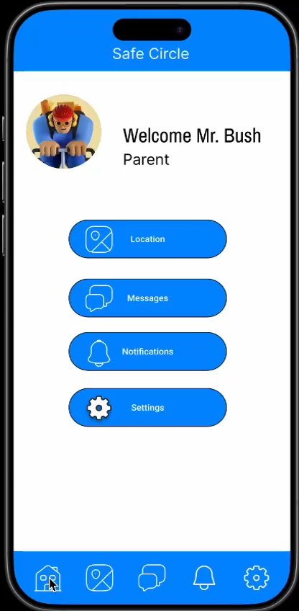
SafeCircle – Our Solution
Core Aspects:
SafeCircle App:
Parents
Real-Time Geolocation
Geolocation Tracking
Privacy Controls
Communication and Attendance Tracking
Attendance check
Direct Messaging
Teachers/Coaches
Direct message
Attendance list

Slide 4
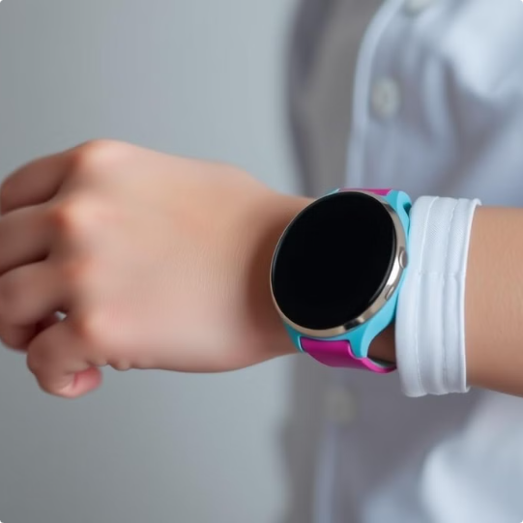
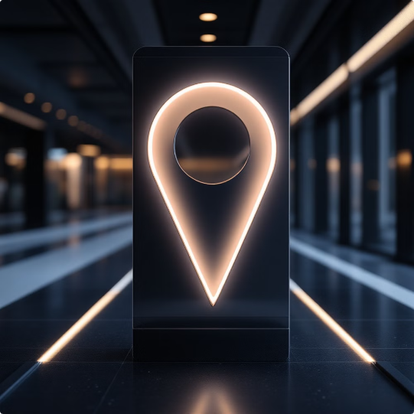

Visual Representation
GPS Watch
Location Data
App

Slide 5
Subscription-Based Model
Subscription Fee
Year 1 Target
€60/year per household.
45,000 users → Revenue: €2,700,000.
Key Costs:
Technology: €170,000–€300,000
Personnel: €300,000–€400,000
Marketing: €125,000–€135,000
Total costs: €595,000–€835,000
Future Revenue Stream
Partnership with GPS-enabled wearable devices preloaded with SafeCircle.

Slide 6
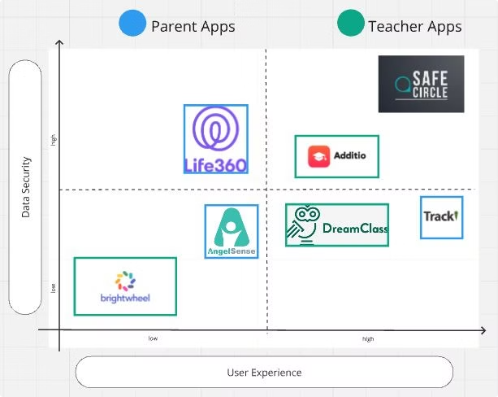
A Unique Position in the Market
SafeCircle combines the benefits of parental control apps (e.g., Life360, AngelSense) with tools used by teachers (e.g., Additio, Brightwheel).
Strength: Professional, real-time safety and communication for parents and caregivers.

Slide 7
How Big is the Opportunity?
4.08M
1.94M
PAM
TAM
German Households with children aged 6–14.
Tech-savvy, smartphone-using parents.
872K | 52.3M
44K | 2.61M
SAM
SOM
Households willing to pay.
Potential Targeted Families

Slide 8
Market Strategy
Target
Distribution Channels
Parents of School-aged Children (ages 6 - 14)
App Stores (App Store & Play Store)
Teachers, Coaches, and Caregivers (In- App Invitation)
Website and Social Media
In-App Invitation
School Partnership (public and private)

Slide 9
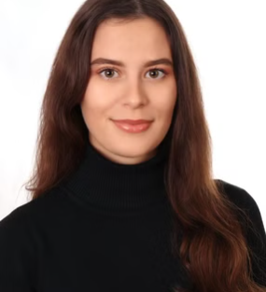
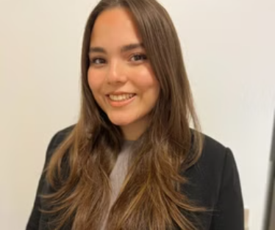
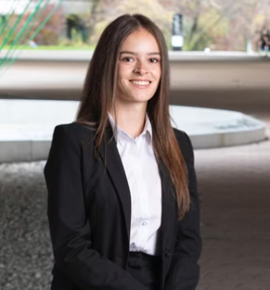
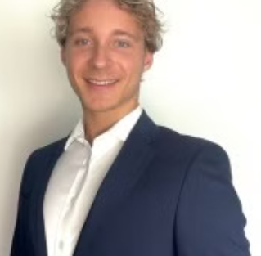
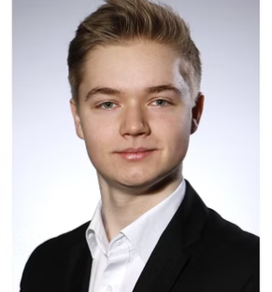




Meet the Visionaries Behind SafeCircle
Elanur & Angela (Creative Leads)
Anastasia (CEO)
Thibaud (CMO)
Matthias (CTO)
Strategic oversight and business planning.
Builds partnerships and drives adoption.
Leads technology development.
UX/UI design and digital marketing experts.

Slide 10
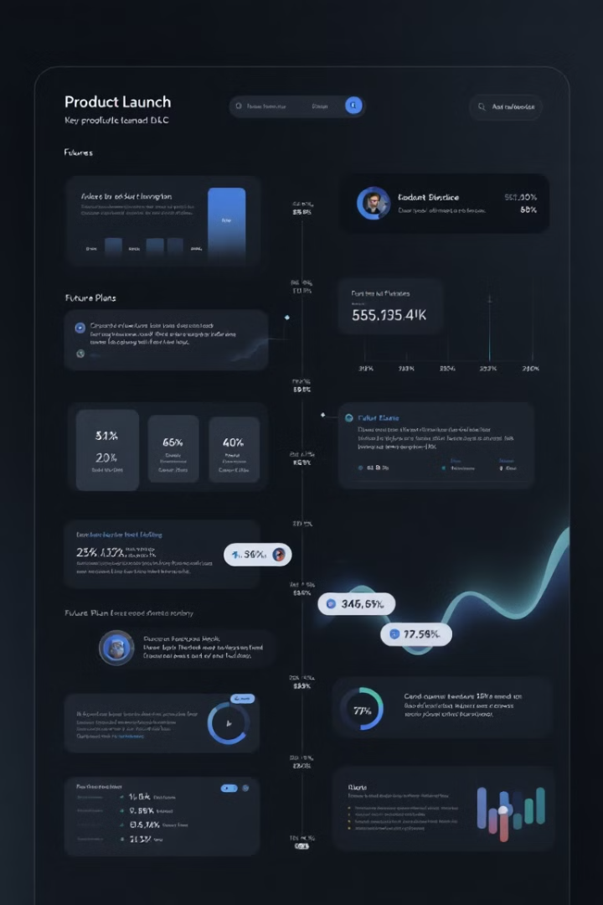
Current Status and Future Plans
1
Current Progress
Development of a Beta version of the App
GDPR compliant
2
Future Milestones
3 Months: Finalize app beta and implement user feedback
& launch marketing campaigns
6 Months: Germany launch & Build partnerships
12 Months: Achieve 45,000 active paying users
18-24 Months: EU expansion & Collaboration with
connected watches.

Slide 11
How can you help us?
What are we looking for?
Why now and why us?
Investment
Growing demand for child safety tools.
Partnership
Rapid adoption of technology-driven parenting solutions.
Our roadmap and vision are defined; your support will accelerate our success.

Slide 12

Join us in creating SafeCircle and ensuring every parent has peace of mind. Let’s circle up for safety!

